Slide 1
DATA MODELLING

Slide 2
🎨 What is Data Modeling?
Data modeling is the process of creating a visual representation of data, its structure, relationships, and constraints before implementing the database.
Why is Data Modeling Important?
✓ Helps plan database before creating tables
✓ Ensures data organization is logical and efficient
✓ Reduces data redundancy and improves data quality
✓ Makes communication easier between developers and stakeholders
Notes:
Data Modeling is the process of creating a visual representation of how data should be organized in a database.
OR
Data Modeling is simply planning a database before creating it.
It can be drawn by an individual or by a group, depending on the size of the project.
one person usually draws it, but the whole team reviews and approves it.
For example:
Team
Database Module
User TeamUser, Login, Profile
Shopping TeamProduct, Cart, Wishlist
Order TeamOrders, Payments
Delivery TeamDelivery, Tracking
Support TeamComplaints
Each team designs its own ER diagram.
Later, all the diagrams are combined into one large database design.
Who Actually Draws It?
Business Analyst (BA) Understands the client's requirements.
Doesn't usually draw the final ER diagram but provides the requirements.
Database Designer / Database Architect Creates the ER diagram.
Decides entities, attributes, relationships, keys, and constraints.
Developers Review the design.
Suggest changes if needed.
Client / Stakeholders Verify that the design meets business needs.

Slide 3
❓ WHY: Do We Need the ER Model?
WITHOUT IT ❌
WITH IT ✅
Problems & Chaos:
Benefits & Solution:
• ER diagram communicates clearly to everyone
• Hard to discuss database design with non-technical people
• Standard symbols understood by all database professionals
• No standard way to represent data structure visually
• Clear understanding prevents costly mistakes later
• Misunderstandings between developer and client
• Difficult to identify all entities & relationships
• Systematic way to find all entities & relationships
• Cannot visualize relationships before coding
• See complete picture before writing any code

Slide 4
📊 Entity-Relationship (ER) Model
The Entity-Relationship (ER) model is a high-level data model that describes the structure of a database.
Introduced by Chen (1976)
Three Main Components:
1. ENTITY
2. ATTRIBUTE
3. RELATIONSHIP
A thing or object in real world that can be identified uniquely
Example: Student, Teacher, Course, Book
A property or characteristic of an entity
Example: Student has Name, ID, Age, Email, GPA
Association between two or more entities
Example: Student enrolls in Course
Notes:
Real world objects that can be uniquely identified

Slide 5
🏷️ Entities and Attributes
ENTITY
ATTRIBUTES
Real-world object that can be uniquely identified
Properties/characteristics that describe an entity
• Student (person)
Types of Attributes:
• Course (academic class)
• Simple: Single value
• Book (physical object)
• Composite: Multiple parts
• Department (organizational)
• Multi-valued: Multiple values
• Teacher (person)
• Derived: Calculated value
• Key: Unique identifier
Example: Student Entity Attributes
Attribute | Type | Example
StudentID | Key | 12345
Name | Simple | Rajesh Kumar
Address | Composite | Mumbai, Maharashtra
PhoneNumbers | Multi-valued | 9876, 9123

Slide 6
❓ WHY: Do We Need ER Diagram Symbols?
WITHOUT IT ❌
WITH IT ✅
Problems & Chaos:
Benefits & Solution:
• Drawings look different to different people
• Standard symbols = everyone draws same way
• Each person draws entities differently
• Rectangle for entity, oval for attribute, diamond for relationship
• Hard to understand other's diagrams
• Any DB professional understands the diagram instantly
• Communication fails across teams/organizations
• Teams communicate effectively using same notation
• Cannot standardize database design process
• Consistent, professional approach to design

Slide 7
📐 ER Diagram Symbols & Notations
Standard symbols used to draw ER Diagrams (Chen's Notation)
ENTITY
Rectangle represents an entity
Attribute
Ellipse/Oval represents an attribute
Relationship
Diamond represents a relationship
ID
Attribute with underline = Primary Key
Calculated
Dashed oval = Derived/Calculated attribute
Cardinality Notations (on relationship lines):
1 (one) | M or N (many) | 0..1 (zero to one) | 1..* (one to many)
Notes:
If the value can be calculated,
it is usually a Derived Attribute.
Eg : Age from DOB
Percentage from Marks
Total amount from Price + Quantity

Slide 8
📐 ER Diagram Symbols & Notations
Standard symbols used to draw ER Diagrams (Chen's Notation)
Multivalued Attribute
Identifying relationship
Composite attribute
Weak entity
Notes:
A multivalued attribute is an attribute that can have more than one value for a single entity.
ER Symbol: Double Oval
Eg : student phone number : one stud many number
Hobbies : Many hobbies
Emp skills : Java,python etc
Customer email id : Many
Language : Multiple
"Not every entity in a database can exist independently.
Some entities depend on another entity for their identity.
To connect such entities, we use something called an Identifying Relationship."
Employee -> Wife,son etc
Normal relationship
→ Single Diamond
Identifying Relationship
→ Double Diamond
Weak entity : "Weak means something that cannot stand alone.
Similarly,
a weak entity cannot exist independently."
A weak entity is an entity that cannot be uniquely identified by its own attributes and depends on another entity for its existence.
Strong entity : Employee (Has Emp_Id)
Weak entity : Dependent
DependentName alone isn't enough.
EmployeeID is also required.

Slide 9
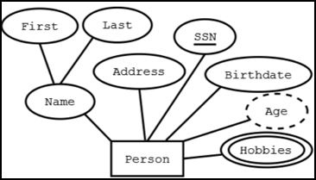
Example :

Slide 10
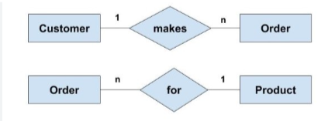
Understanding Relationships
A relationship describes how entities (tables) are connected. It defines how data in one table relates to data in another table through Foreign Keys.
Notes:
Relationship tells us what connects two entities.
Example: Student enrolls in Course.
Cardinality tells us how many instances participate in that relationship.
Example: One student can enroll in many courses, and one course can have many students, so the cardinality is Many-to-Many (M:N).

Slide 11
Cardinality Ratios
Three Cardinality Ratios
1:1 (One-to-One)
1:N (One-to-Many)
M:N (Many-to-Many)
STUDENT ↔ PASSPORT
DEPARTMENT → STUDENT
STUDENT ↔ COURSE
Each student has exactly one passport; each passport belongs to exactly one student
One department has many students; each student belongs to one department
Many students enroll in many courses (requires junction table)
Real-world Example:
Real-world Example:
Real-world Example:
PERSON ↔ DRIVER_LICENSE
One person has one driver's license
One license is for one person
UNIVERSITY ↔ STUDENT
One university has many students
Each student attends one university
EMPLOYEE ↔ PROJECT
Many employees work on many projects
Many projects have many employees

Slide 12
One-to-One (1:1) Relationships
Definition: Each record in one table corresponds to exactly one record in another table.
STUDENT
1:1
PASSPORT
How to Implement (Method 1: FK in STUDENT table):
StudentID (PK) | Name | PassportID (FK, UK)
S001 | Amit Kumar | P001
S002 | Priya Sharma | P002
PassportID (PK) | PassportNumber | ExpiryDate
P001 | AB12345678 | 2025-06-15
P002 | CD87654321 | 2026-12-20
Key: PassportID is UNIQUE in STUDENT table to enforce 1:1 relationship
Notes:
Slide 9: One-to-One
Example
Person ↔ Passport
One passport
One person
Another example
Vehicle ↔ Engine Number
One engine belongs to one vehicle.

Slide 13
One-to-Many (1:N) Relationships
Definition: One record in table A can relate to many records in table B, but each record in B relates to only one record in A.
DEPARTMENT
1:N
STUDENT
DEPARTMENT Table (Parent):
STUDENT Table (Child):
DeptID (PK) | DeptName
D01 | Computer Science
D02 | Business Admin
StudentID (PK) | Name | DeptID (FK)
S001 | Amit | D01
S002 | Priya | D01
S003 | Rajesh | D02
Implementation: Foreign Key (DeptID) is placed in the CHILD table (STUDENT). This allows multiple students to have the same DeptID.
Notes:
One-to-Many
Best example
Department → Students
Computer Science
↓
Rahul
Asha
Vivek
Priya
Many students
One department
Ask
"Can one student belong to two departments?"
Generally No.

Slide 14
Many-to-Many (M:N) Relationships
Definition: Many records in table A can relate to many records in table B. Requires a junction/bridge table to implement.
STUDENT
M:N
COURSE
Three Tables Needed:
STUDENT:
ENROLLMENT (Junction):
COURSE:
StudentID (PK) | Name
S001 | Amit
S002 | Priya
StudentID (FK) | CourseID (FK) | Grade
S001 | C01 | A+
S001 | C02 | B+
S002 | C01 | A
CourseID (PK) | Name
C01 | Database
C02 | Java
Key Point: The ENROLLMENT table is a junction/bridge table that resolves the M:N relationship.
It has TWO Foreign Keys (StudentID and CourseID) and optional attributes (Grade, EnrollDate, etc.). These two FKs together form the Primary Key.

Slide 15
Relationship vs. Cardinality: Key Difference
RELATIONSHIP
CARDINALITY
WHAT connection exists?
HOW MANY participate?
▸ Describes HOW entities
are connected
▸ Quantitative ratio:
1:1, 1:N, M:N
▸ Specifies the relationship between entities
▸ Specifies NUMBER of
instances in relationship
▸ Example: Student
ENROLLS-IN Course
▸ Example: One Student
enrolls in MANY Courses

Slide 16
Cardinality Notation: Chen's ER Model
Mathematical Notation (Elmasri & Navathe, 2016):
(1,1)
Exactly one
Each student has EXACTLY one StudentID
(0,1)
Zero or one
A student may have ZERO or ONE scholarship
(1,N)
One or more
A department has AT LEAST ONE student
(0,N)
Zero or more
A student enrolls in ZERO or MORE courses

Slide 17
Cardinality: The Heart of Relationships
Cardinality specifies the NUMBER of records from one entity that can be associated with records from another entity. It defines the ratio of records in a relationship.
Cardinality Notations: (Min to Max)
1
Exactly One
Each student has exactly 1 ID
0 or *
Zero or More
A department may have 0 or many students
0..1
Zero or One
A student may have 0 or 1 scholarship
1..N
One or More
A student takes at least 1 course
Notes:
"Relationship tells WHAT.
Cardinality tells HOW MANY."
Example
Teacher teaches Student.
Relationship
Teaches
Cardinality
One teacher
↓
50 students

Slide 18
ER Diagrams: Design & Visualization
What is ER Diagram?
Visual representation of entities (tables), attributes (columns), and relationships between them using boxes, diamonds, and connecting lines.
Who Refers to ER Diagrams?
Database Designers:
Plan database structure before implementation
Developers:
Understand table relationships and write correct SQL
Business Analysts:
Document requirements and data structures
Database Administrators:
Manage, optimize, and maintain databases
Project Teams:
Communication and documentation across teams

Slide 19
ER Diagram: Cardinality & Participation Notation
How to Read ER Diagrams:
Example 1: DEPARTMENT → STUDENT (1:N)
Has
1
N
DEPARTMENT
STUDENT
Single line = Partial participation
Double line = Total participation (every department has students)
Example 2: STUDENT ↔ COURSE (M:N)
M
Enrolls
N
STUDENT
COURSE
Both sides are double-lined = Both entities have total participation
Example 3: STUDENT ↔ PASSPORT (1:1)
Has
STUDENT
1
1
PASSPORT
Each customer has exactly one driving license and every driving license is associated with exactly one customer.
Notes:
ORDER ===== Contains ===== ORDER_ITEM
|| ||
(total) (total)
An order cannot exist without at least one order item.
An order item cannot exist without belonging to an order.
So both sides have total participation.
Cardinality:
ORDER (1) -------- (M) ORDER_ITEM
Participation:
ORDER → Total
ORDER_ITEM → Total
Every entity must have a relationship = Total participation
Some entities may not have a relationship = Partial participation

Slide 20
Complete College Database Example
All Concepts Combined:
DEPARTMENT
DeptID(PK)
DeptName
STUDENT
StudentID(PK)
Name
DeptID(FK)
COURSE
CourseID(PK)
CourseName
Credits
1:N
ENROLLMENT
StudentID(FK)
CourseID(FK)
Grade
INSTRUCTOR
InstructorID(PK)
Name
DeptID(FK)
1:N
1:N
1:N
Constraints in this Model:
• DEPT (1:N) STUDENT: Every student must belong to a department (total participation)
• STUDENT (M:N) COURSE: via ENROLLMENT table (both optional)
• DEPT (1:N) INSTRUCTOR: One department has many instructors (total on DEPT side)
• StudentID NOT NULL, Email UNIQUE in STUDENT table
• DeptID is Foreign Key in both STUDENT and INSTRUCTOR

Slide 21
🎓 Real Example: College Information System
College Database Entities:
STUDENT
DEPARTMENT
COURSE
• DeptID (PK)
• DeptName
• Head
• Location
• StudentID (PK)
• Name
• Email
• GPA
• DeptID (FK)
• CourseID (PK)
• CourseName
• Credits
• TeacherID (FK)
Relationships:
• Student "enrolls-in" Course (M:M) - A student can take many courses, a course can have many students
• Student "belongs-to" Department (M:1) - Many students belong to one department
• Course "taught-by" Teacher (M:1) - Many courses can be taught by one teacher
• Department "has" Teacher (1:M) - One department has many teachers

Slide 22
✍️ Exercise 1: Library Management System
Scenario:
A library needs to maintain information about Books, Authors, and Members. Members can borrow multiple books, and books can be written by multiple authors. Each member can place holds on books.
Tasks:
1. Identify all entities needed for this system
2. List attributes for each entity (including primary keys)
3. Define relationships between entities with cardinality (1:1, 1:M, M:M)
4. Draw the ER diagram using rectangles for entities, ovals for attributes, and diamonds for relationships
Expected Entities: Book, Author, Member, Hold | Relationships: Written-by (M:M), Borrows (M:M), Places (1:M)
Notes:
In your ER diagram, HOLD is modeled as an entity, not just the relationship "holds". That changes the cardinality.
Let's understand it with an example.
What does HOLD represent?
A Hold is a reservation record.
For example:
Hold_ID
Member_ID
Book_ID
Hold_Date
H101M1B1024-Jul-2026
H102M1B2525-Jul-2026
H103M2B1026-Jul-2026
Notice:
Member M1 has created 2 holds.
Member M2 has created 1 hold.
Each Hold belongs to only one member.
So,
MEMBER 1 -------- M HOLD
means
One member can place many holds.
Every hold is placed by exactly one member.
Hence 1:M.
Why not M:M?
If you directly connect MEMBER and BOOK, then yes, the relationship is naturally Many-to-Many.
MEMBER -------- Places Hold -------- BOOK
M M
Example:
One member can reserve many books.
One book can be reserved by many different members (at different times).
This is an M:M relationship.

Slide 23
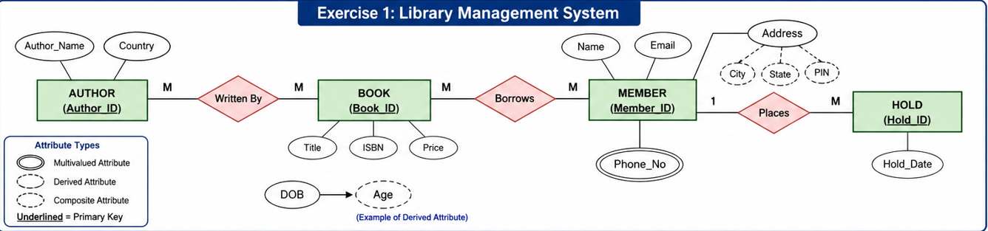

Slide 24
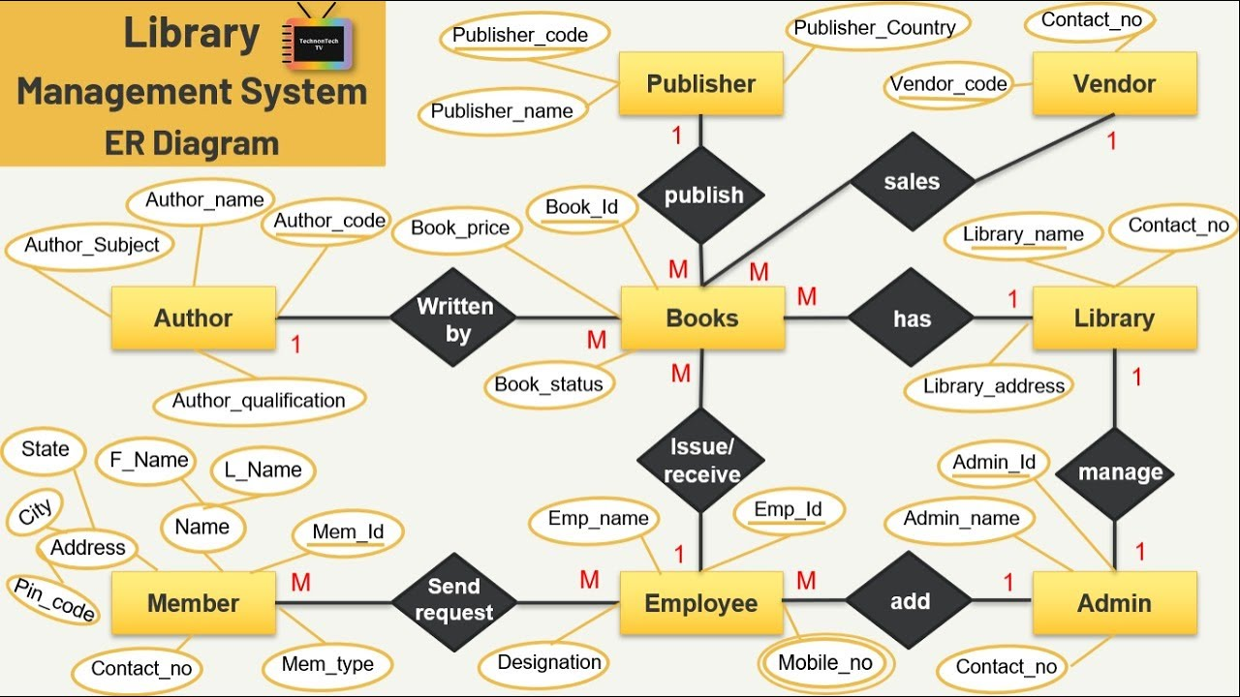

Slide 25
✍️ Exercise 2: Hospital Management System
Scenario:
A hospital manages Patients, Doctors, and Departments. Each patient is assigned to a doctor. Doctors work in departments. Patients may have multiple medical records and visits.
Tasks:
1. Identify entities (Patient, Doctor, Department, MedicalRecord, Visit, etc.)
2. Define attributes with data types
3. Identify primary and foreign keys
4. Determine cardinality ratios for all relationships
5. Specify participation constraints (Total vs Partial)
Expected: Patient (M:1) Doctor, Doctor (M:1) Department, Patient (1:M) MedicalRecord, Patient (1:M) Visit

Slide 26
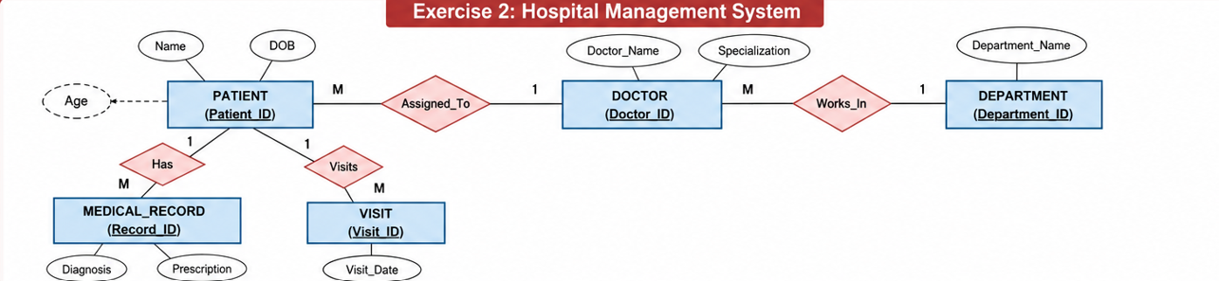
Makes

Slide 27
✍️ Exercise 3: E-Commerce System
Scenario:
An online shopping platform has Customers, Orders, Products, and Categories. Each order contains multiple products. Products belong to categories. Customers can place multiple orders.
Tasks:
1. List all required entities and their attributes
2. Define all primary keys and candidate keys
3. Identify foreign keys and relationships
4. Determine M:M relationships that need bridge tables
5. Create complete ER diagram with proper notation
Expected: Customer (1:M) Order, Product (M:1) Category, Order (M:M) Product (via OrderItem bridge table)

Slide 28
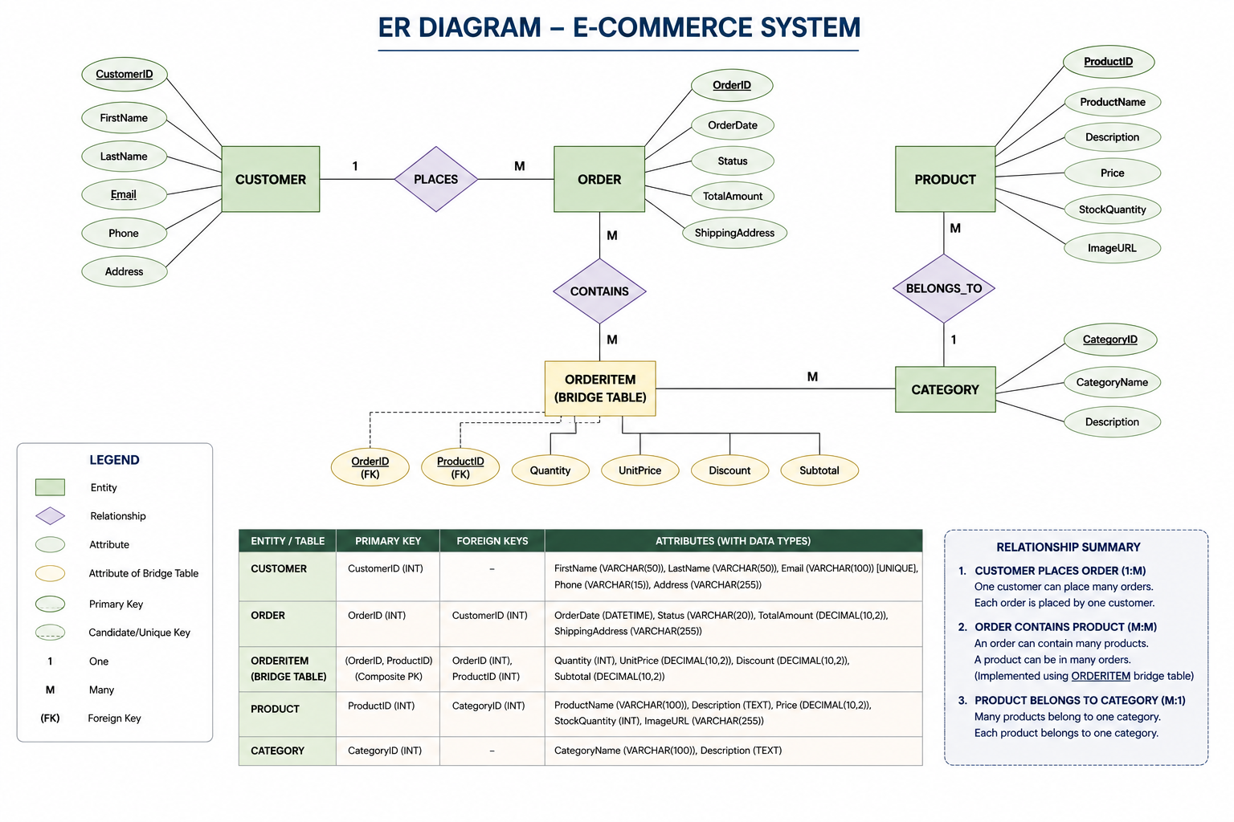

Slide 29
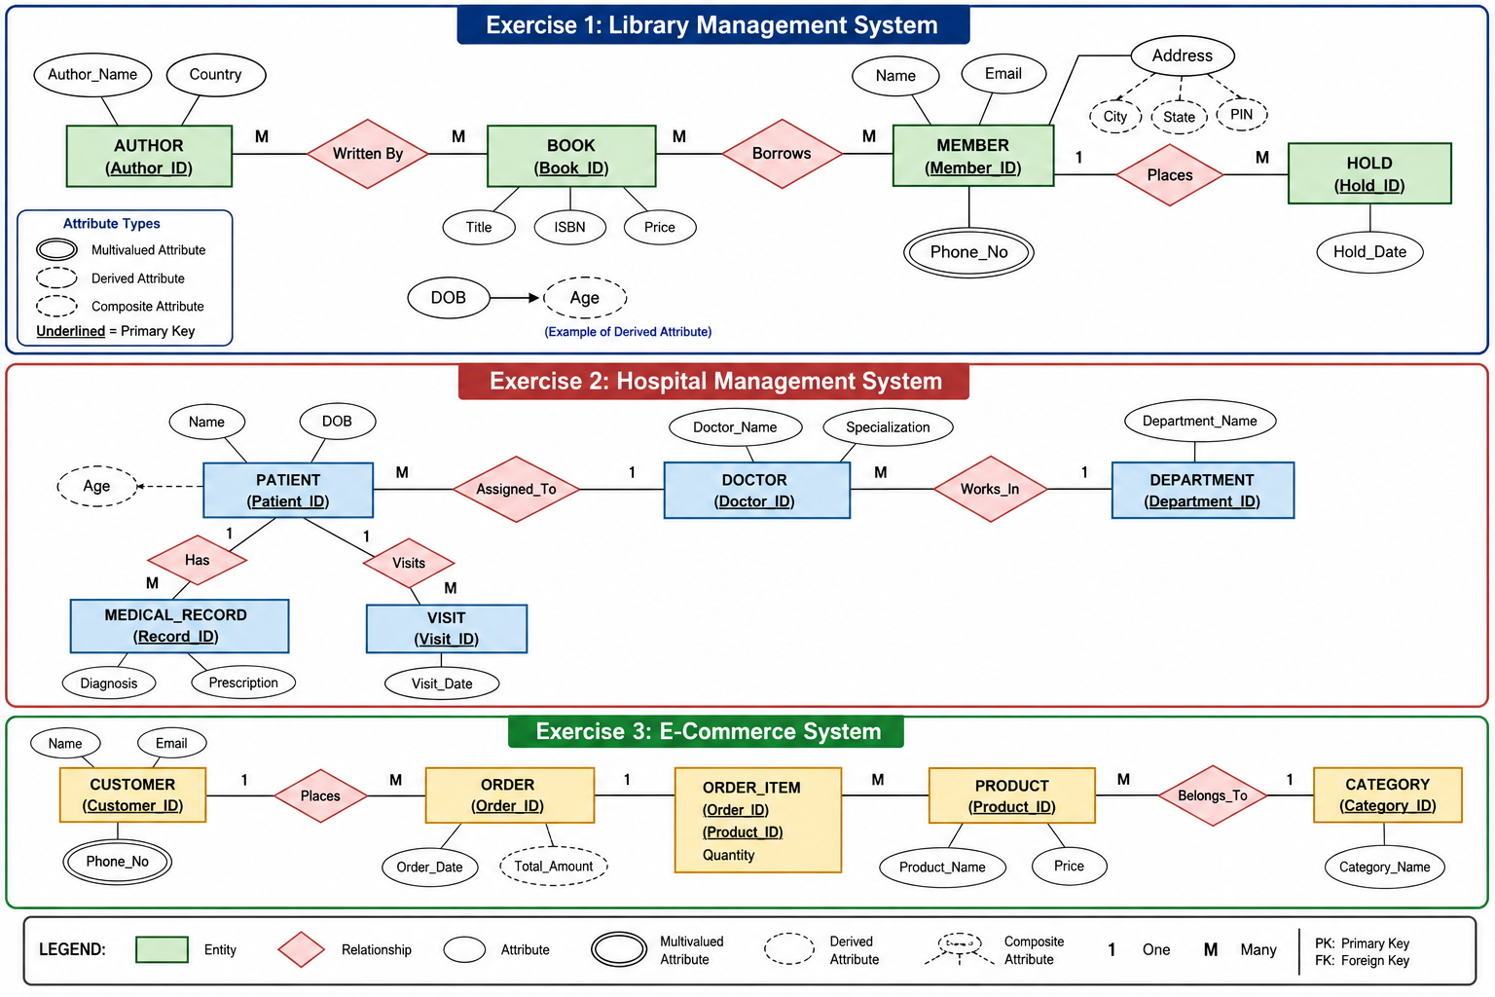
Makes

Slide 30
Participation Constraints: TOTAL vs PARTIAL
Participation specifies whether ALL instances of an entity must participate in a relationship or only SOME can participate.
TOTAL (Mandatory)
PARTIAL (Optional)
ALL records must participate
SOME records may participate
✓ Every STUDENT must enroll in
at least one COURSE
◇ Some STUDENTS may NOT have
SCHOLARSHIPS
✓ Every EMPLOYEE must work for
a DEPARTMENT
◇ Some EMPLOYEES may NOT
supervise anyone
✓ Foreign Key = NOT NULL
(enforces mandatory participation)
◇ Foreign Key can be NULL
(allows optional participation)
✓ Double line in ER diagram
◇ Single line in ER diagram
Notes:
Cardinality → HOW MANY?
Participation → MUST or MAY?
Every entity must have a relationship = Total participation
Some entities may not have a relationship = Partial participation
Total Participation (Mandatory)
Definition
Every entity must participate in the relationship.
No record can exist without participating.
Symbol
Double line in ER Diagram.
STUDENT ═════ Belongs To ───── DEPARTMENT
(Double line on Student side)
[ DeptID INT NOT NULL ]
Since Department is compulsory,
Foreign Key is NOT NULL.
Partial Participation (Optional)
Definition
Participation is optional.
Some records may participate.
Some may not.
Symbol
Single line.
STUDENT ───── Gets ───── SCHOLARSHIP
Do all students receive scholarships?
No.
Some students receive scholarships.
Some don't.
Therefore,
STUDENT has Partial Participation.

Slide 31
THANK YOU

